Slide 1
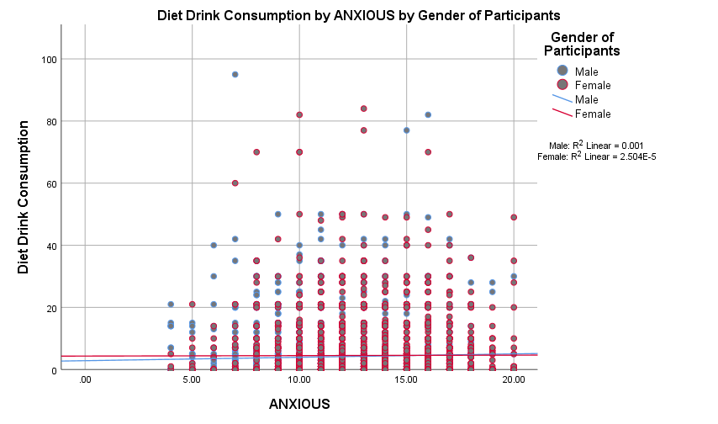
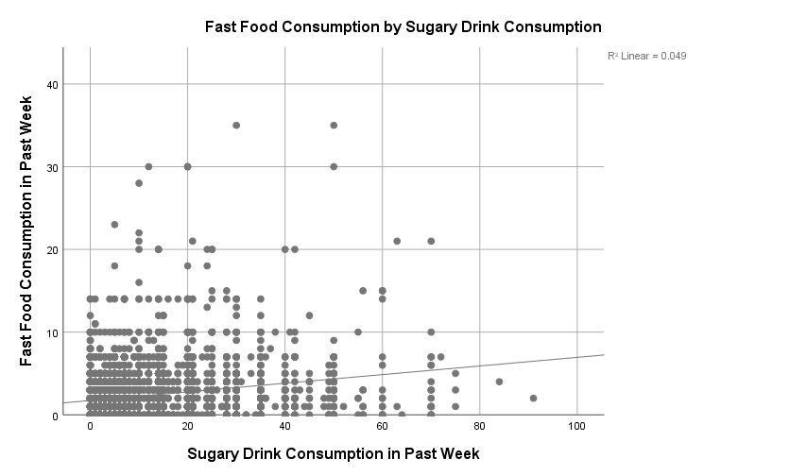
The Association Between Fast Food/Sugary Drink Consumption and Anxiety/Depression Symptoms
Katherine Jensen
Introduction
Methods
Conclusion
It is widely accepted knowledge that an unhealthy diet containing large amounts of fast food and sugary drinks increases the risk of developing certain diseases such as Cardiovascular Disease and Diabetes, but the relationship between unhealthy eating habits and developing mental health disorders is still being debated.
Gender has been shown to affect whether anxiety symptoms will occur together with fast food consumption.
A significant relationship has previously been shown between anxiety and fast food consumption in females only, while the relationship between fast food consumption and depression is significant in both genders.
Consumption of sugary drinks containing artificial sweeteners have been associated with depressive symptoms while sugary drinks containing regular sugar or honey have not.
This study will focus on the relationship between consuming fast food, sugary drinks, and diet drinks and anxiety/depression symptoms. The relationship between anxiety/depression and gender will be considered as well.
Study Sample
Data was collected form the ADDHEALTH data set
Participants were selected if they reported to all variables completely
Statistical Methods
Multivariate Linear regression was used to build models
Depression, anxiety, and gender were modeled to determine their effects on fast food consumption, sugary dink consumption, and diet drink consumption
Variables Used in Study
Gender of Participants
Diet Variables Depression Variables (Recoded into scale Variable CESD
Fast Food Consumption in Past Week (Frequency) -Bothered by things that don’t usually bother you in past week
Sugary Drink Consumption in Past Week (Frequency) -Could not shake off blues in past week
Diet Drink Consumption in Past Week (Frequency) -Had trouble focusing in past week
-Feelings of depression in last 7 days
-Felt sad in past week Anxiety Variables (Recoded into scale Variable ANXIOUS)Those with asterisk were reverse coded
I worry about things*
I am not easily bothered by things
I get stressed out easily*
I don’t worry about things that have already happened
Depression scale score was significantly associated with fast food consumption in the past week (p<.001).
A one unit on the depression scale increases, fast food meal consumption increases by 1 meal when controlling for gender. Many other studies investigating the relationship between depression and fast food consumption have also found a significant relationship between the two (1, 2).
Anxiety levels were not significantly associated with fast food consumption and this relationship did not differ among the genders. This does not align with previous research for one study found a significant and positive relationship between stress and fast food consumption among females only (2).
There was a significant and positive relationship between depression and sugary drink consumption (p<.001) and this finding does not align with previous studies that did not find a significant relationship between depression and sugary drink consumption (2, 3).
Sugary drinks were significantly and positively associated with anxiety only after controlling for gender (p=.001), other studies have found that anxiety only affects female dietary habits not males (2, 4).
Depression was significantly and negatively associated with diet drink consumption (p=.49) and this is opposite of previous studies that found diet drinks to be positively associated with depression (3).
Diet drink consumption was not significantly associated with depression
Results
Objectives
References
Is there a relationship between sugar sweetened drinks (diet/non-diet) on depression symptoms?
Is there a relationship between both fast food consumption and sugar sweetened drink consumption on anxiety?
Is there a relationship between the frequency of fast food consumption and depression symptoms?
1.) Sánchez-Villegas A, Toledo E, de Irala J, Ruiz-Canela M, Pla-Vidal J, Martínez-GonzálezMA.2012 Mar. Fast-food and commercial baked goods consumption and the risk of depression. Public Health Nutrition, 15(3):424-32. doi: 10.1017/S1368980011001856.
2.) El Ansari W, Adetunji H, Oskrochi R. 2014 Jun. Food and mental health: relationship between food and perceived stress and depressive symptoms among university students in the United Kingdom. Cent Eur J Public Health.
3.) Guo X, Park Y, Freedman ND, Sinha R, Hollenbeck AR, Blair A, Chen H. 2014 April 17.Sweetened beverages, coffee, and tea and depression risk among older US adults. PLoS One,9(4):e94715. doi: 10.1371/journal.pone.0094715.
4.) Bakhtiyari M1, Ehrampoush E, Enayati N, Joodi G, Sadr S, Delpisheh A, Alihaydari J, Homayounfar R. 2013 Apr. Anxiety as a consequence of modern dietary pattern in adults in Tehran--Iran. Eat Behav, 14(2):107-12. doi: 10.1016/j.eatbeh.2012.12.007.

